Slide 1
3.1 ECMA Script
Nathaniel Breeden, Christopher Combs, Bryce Moore, Jonathan Winston, Da'Montaye Snipes

Slide 2
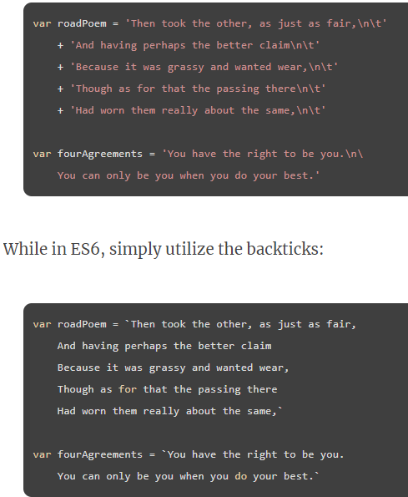
How would you use the feature in an application interface context?
Multiline Strings: By using back ticks ( ` ) you can have a string of code be multiple lines without using + or \n.
This can be helpful as it saves time by shortening what you type and makes your code look neater and easier to read.

Slide 3
What information could have been added to your selected features based on other sources of information you’ve found?
You can insert data directly into the string by using `${data}`. You won't have to use any pluses.
It has an interpolation operator that can evaluate random content so you can use more than already declared variables.

Slide 4
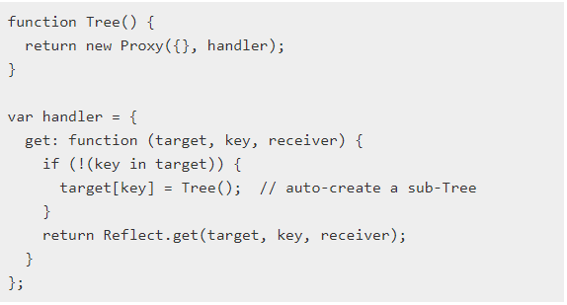
How would you use the feature in an application interface context?
Proxies: By using the target and handler parameters, an object will not only be interpreted, but also redefine fundamental operations of an object that you're creating a proxy for. It also gives host a full range of behaviors available to host objects.

Slide 5
What information could have been added to your selected features based on other sources of information you’ve found?
Is a key part of security
Microsoft edge and firefox only support proxies
Uses weakmaps to save data to cache
When proxies are revocable once revoked it is not able to be used again
Can restrict access form user using readonlyview command
Records every time an eventhandler is used

Slide 6
References
Mardan, A. (2015, November 10). Top 10 ES6 Features Every Busy JavaScript Developer Must Know. webapplog [tech blog]. https://webapplog.com/es6/.
Tarantino, J. (2015, November 29). Multiline strings in ES6 JavaScript. Jack Tarantino. https://jack.ofspades.com/multiline-strings-in-es6-javascript/.

